Slide 1
Proyectos para el Area de Short term
Retirar Notch en los catheters Duo jet.
Corte en Linea PT17006.
Remover Pulido en catheteres Triflow.
Reducir Tiempos de curado.
Lideres de Proyectos
Eduardo Sepulveda, Saul Ruiz , Jesus Garcia

Slide 2
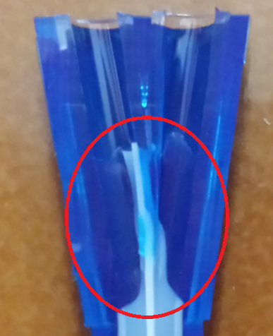
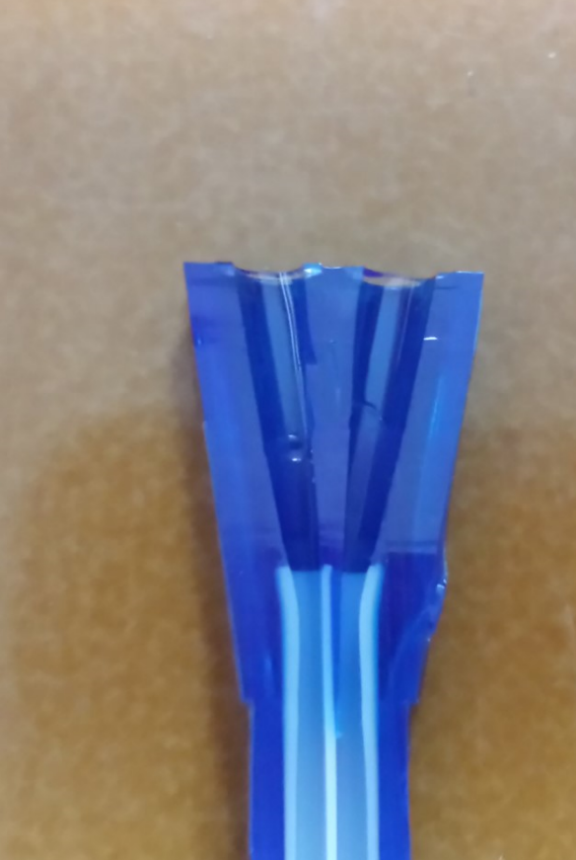
Removed Nocth

Slide 3
Definition:
Currently tube PT17006 is cut after extrusion at 12”; however, this tube is used to manufacture 11 different dimensions of catheters from 10cm to 25 cm, this project is to reduce the waste of this tube.
Scope:
Products that uses PT17006 .
Defect:
Waste of PT17006 per catheter.
Expected benefits:
Benefits for the customer:
Delivery Time.
Benefits for the company.
Operating cost reduction.
Scrap reduction.
Output improvement.

Slide 4
Base line
PART NUMBER | DESCRIPTION | CUT IN EXTRUSION | CUT BEFORE MOLD | WASTE
AC1010HFC | 11FX10CM PELL IJ HIGHFLOW SXS | 12 | 4.937 | 7.063
AC1002HF | 11F X 4.75HI-FLO SXS; NO LOGO | 12 | 5.574 | 6.426
AC1002HFC | 11FX12CM IJ HI-FLO SXS;NO LOGO | 12 | 5.574 | 6.426
AC4090 | 12FX13CM DUOJET SXS GEN CURVED | 12 | 6.118 | 5.882
AC1011HFC | 11FX13.5CM IJ HI-FLOW SXS | 12 | 6.315 | 5.685
AC4294 | 12FX15CM DUOJET SXS CV/GENERIC | 12 | 6.609 | 5.391
AC4294NP | 12FX15CM DUOJET SXS CURV-NIPRO | 12 | 6.609 | 5.391
AC1003HF | 11FX6" HIGH FLOW SXS; NO LOGO | 12 | 6.609 | 5.391
AC1003HFC | 11FX15CM IJ HI-FLO SXS;NO LOGO | 12 | 6.609 | 5.391
AC4091 | 12FX16CM DUOJET SXS GEN CURVED | 12 | 7.3 | 4.7
AC4211 | 12FX16CM DUOJET SXS GEN STR | 12 | 7.3 | 4.7
AC4295 | 12X20CM DUOJET SXS CV/GENERIC | 12 | 8.874 | 3.126
AC4295NP | 12FX20CM DUOJET SXS CURV-NIPRO | 12 | 8.874 | 3.126
AC1004HF | 11FX8" HIGH FLOW SXS; NO LOGO | 12 | 8.874 | 3.126
AC1004HFC | 11FX20CM IJ HI-FLOWSXS;NO LOGO | 12 | 8.874 | 3.126
AC4092 | 12FX21CM DUOJET SXS GEN CURVED | 12 | 9.268 | 2.732
AC1220 | 12FX24CM DUOJET SXS STRAIGHT | 12 | 10.449 | 1.551
AC1220C | 12FX24CM DUOJET SXS CURVED | 12 | 10.449 | 1.551
AC4216 | 12FX24CM DUOJET SXS STRAIGHT | 12 | 10.449 | 1.551
AC1005HF | 11FX9.5" HIGH FLOW SXS NO LOGO | 12 | 10.449 | 1.551
COST PT17006
0.246
COST PER INCH
0.0205

Slide 5
Base line
RM’s 2019

Slide 6
Current waste cost
PART NUMBER | DESCRIPTION | CUT IN EXTRUSION | CUT BEFORE MOLD | TOLERANCIA | WASTE | RM's 2019 | WASTE COST
AC1010HFC | 11FX10CM PELL IJ HIGHFLOW SXS | 12 | 4.937 | 0.062 | 7.063 | 375 | $ 54.30
AC1002HF | 11F X 4.75HI-FLO SXS; NO LOGO | 12 | 5.574 | 0.062 | 6.426 | 591 | $ 77.85
AC1002HFC | 11FX12CM IJ HI-FLO SXS;NO LOGO | 12 | 5.574 |  | 6.426 | 2653 | $ 349.49
AC4090 | 12FX13CM DUOJET SXS GEN CURVED | 12 | 6.118 | 0.100 | 5.882 | 2161 | $ 260.58
AC1011HFC | 11FX13.5CM IJ HI-FLOW SXS | 12 | 6.315 | 0.062 | 5.685 | 800 | $ 93.23
AC1218 | 12FX15CM DUOJET SXS STRAIGHT | 12 | 6.609 | 0.100 | 5.391 | 2239 | $ 247.44
AC1218C | 12FX15CM DUOJET SXS CURVED | 12 | 6.609 |  | 5.391 | 12155 | $ 1,343.32
AC4214 | 12FX15CM DUOJET SXS STR GENER | 12 | 6.609 |  | 5.391 | 33207 | $ 3,669.89
AC4214NP | 12FX15CM DUOJET SXS STR-NIPRO | 12 | 6.609 |  | 5.391 | 2408 | $ 266.12
AC4294 | 12FX15CM DUOJET SXS CV/GENERIC | 12 | 6.609 |  | 5.391 | 38916 | $ 4,300.82
AC4294NP | 12FX15CM DUOJET SXS CURV-NIPRO | 12 | 6.609 |  | 5.391 | 7527 | $ 831.85
AC1003HF | 11FX6" HIGH FLOW SXS; NO LOGO | 12 | 6.609 |  | 5.391 | 25112 | $ 2,775.27
AC1003HFC | 11FX15CM IJ HI-FLO SXS;NO LOGO | 12 | 6.609 |  | 5.391 | 23553 | $ 2,602.97
AC4091 | 12FX16CM DUOJET SXS GEN CURVED | 12 | 7.3 | 0.100 | 4.7 | 8582 | $ 826.88
AC4211 | 12FX16CM DUOJET SXS GEN STR | 12 | 7.3 |  | 4.7 | 914 | $ 88.06
AC4211-A | 12FX16CM DUOJET SXS STR-SENTIA | 12 | 7.3 |  | 4.7 | 0 | $ -
AC1219 | 12FX20CM DUOJET SXS STRAIGHT | 12 | 8.874 | 0.100 | 3.126 | 10040 | $ 643.39
AC1219C | 12FX20CM DUOJET SXS CURVED | 12 | 8.874 |  | 3.126 | 6590 | $ 422.31
AC1219C | 12FX20CM DUOJET SXS CURVED | 12 | 8.874
AC4215 | 12FX20CM DUOJET SXS STRAIGHT | 12 | 8.874 |  | 3.126 | 39641 | $ 2,540.31
AC4215NP | 12FX20CM DUOJET SXS STR-NIPRO | 12 | 8.874 |  | 3.126 | 4767 | $ 305.48
AC4295 | 12X20CM DUOJET SXS CV/GENERIC | 12 | 8.874 |  | 3.126 | 17074 | $ 1,094.15
AC4295NP | 12FX20CM DUOJET SXS CURV-NIPRO | 12 | 8.874 |  | 3.126 | 8586 | $ 550.22
AC1004HF | 11FX8" HIGH FLOW SXS; NO LOGO | 12 | 8.874 |  | 3.126 | 33221 | $ 2,128.90
AC1004HFC | 11FX20CM IJ HI-FLOWSXS;NO LOGO | 12 | 8.874 |  | 3.126 | 16106 | $ 1,032.12
AC4092 | 12FX21CM DUOJET SXS GEN CURVED | 12 | 9.268 | 0.100 | 2.732 | 3249 | $ 181.96
AC1220 | 12FX24CM DUOJET SXS STRAIGHT | 12 | 10.449 | 0.100 | 1.551 | 7635 | $ 242.76
AC1220C | 12FX24CM DUOJET SXS CURVED | 12 | 10.449 |  | 1.551 | 1213 | $ 38.57
AC4216 | 12FX24CM DUOJET SXS STRAIGHT | 12 | 10.449 | 0.100 | 1.551 | 4501 | $ 143.11
AC4216NP | 12FX24CM DUOJET SXS STR-NIPRO | 12 | 10.449 |  | 1.551 | 588 | $ 18.70
AC4296 | 12FX24CM DUOJET SXS CV/GENERIC | 12 | 10.449 |  | 1.551 | 1316 | $ 41.84
AC1005HF | 11FX9.5" HIGH FLOW SXS NO LOGO | 12 | 10.449 |  | 1.551 | 5333 | $ 169.57
 |  |  |  |  | TOTAL COST |  | $ 27,341.46
 | PARTS PER HOUR |  |  | COST PER HOUR
 | 300 |  |  | $ 9.79
 | TOTAL PRODUCED 2019 |  |  | NECESSARY HOURS
 | 321,053 |  |  | 1070.18
 |  | PRODUCTION COST
 |  | $ 10,477.03

Slide 7
Proposed
To reduce waste of PT17006 we proposed generate new part numbers with only one specification for each dimension of catheter, generate 10 new part numbers will be necessary, see image below as example.
TUBE | PART NUMBER | DESCRIPTION | CUT EXTRUSION | TOLERANCIA
PT17006 | AC1010HFC | 11FX10CM PELL IJ HIGHFLOW SXS | 4.937 | 0.062
PT17006A | AC1002HF | 11F X 4.75HI-FLO SXS; NO LOGO | 5.574 | 0.062
 | AC1002HFC | 11FX12CM IJ HI-FLO SXS;NO LOGO | 5.574
PT17006B | AC4090 | 12FX13CM DUOJET SXS GEN CURVED | 6.118 | 0.100
PT17006C | AC1011HFC | 11FX13.5CM IJ HI-FLOW SXS | 6.315 | 0.062
PT17006D | AC1218 | 12FX15CM DUOJET SXS STRAIGHT | 6.609 | 0.100
 | AC1218C | 12FX15CM DUOJET SXS CURVED | 6.609
 | AC4214 | 12FX15CM DUOJET SXS STR GENER | 6.609
 | AC4214NP | 12FX15CM DUOJET SXS STR-NIPRO | 6.609
 | AC4294 | 12FX15CM DUOJET SXS CV/GENERIC | 6.609
 | AC4294NP | 12FX15CM DUOJET SXS CURV-NIPRO | 6.609
 | AC1003HF | 11FX6" HIGH FLOW SXS; NO LOGO | 6.609
 | AC1003HFC | 11FX15CM IJ HI-FLO SXS;NO LOGO | 6.609
PT17006E | AC4091 | 12FX16CM DUOJET SXS GEN CURVED | 7.3 | 0.100
 | AC4211 | 12FX16CM DUOJET SXS GEN STR | 7.3
 | AC4211-A | 12FX16CM DUOJET SXS STR-SENTIA | 7.3
PT17006F | AC1219 | 12FX20CM DUOJET SXS STRAIGHT | 8.874 | 0.100
 | AC1219C | 12FX20CM DUOJET SXS CURVED | 8.874
 | AC4215 | 12FX20CM DUOJET SXS STRAIGHT | 8.874
 | AC4215NP | 12FX20CM DUOJET SXS STR-NIPRO | 8.874
 | AC4295 | 12X20CM DUOJET SXS CV/GENERIC | 8.874
 | AC4295NP | 12FX20CM DUOJET SXS CURV-NIPRO | 8.874
 | AC1004HF | 11FX8" HIGH FLOW SXS; NO LOGO | 8.874
 | AC1004HFC | 11FX20CM IJ HI-FLOWSXS;NO LOGO | 8.874
PT17006G | AC4092 | 12FX21CM DUOJET SXS GEN CURVED | 9.268 | 0.100
PT17006H | AC1220 | 12FX24CM DUOJET SXS STRAIGHT | 10.449 | 0.100
 | AC1220C | 12FX24CM DUOJET SXS CURVED | 10.449
PT17006I | AC4216 | 12FX24CM DUOJET SXS STRAIGHT | 10.449 | 0.100
 | AC4216NP | 12FX24CM DUOJET SXS STR-NIPRO | 10.449
 | AC4296 | 12FX24CM DUOJET SXS CV/GENERIC | 10.449
 | AC1005HF | 11FX9.5" HIGH FLOW SXS NO LOGO | 10.449
TOTAL SAVING (CURRENT)
WASTE COST + PRODUCTION COST
$ 37,818.49
TOTAL SAVING (PROYECTED 2020)
WASTE COST + PRODUCTION COST
$ 42,426.77

Slide 8
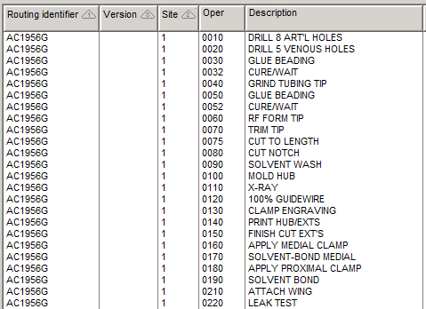
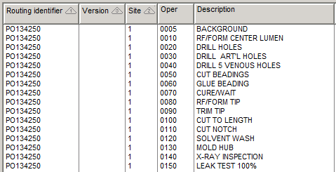
Eliminar Pulido Triflow

Slide 9
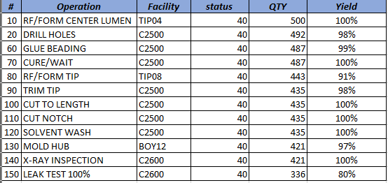
MLGP250-PO134250

Slide 10
Reduccion de Tiempos de curado
SXS – 24H
Duojet- 24H
Triflow- 48H
Coaxial – 24H

